Slide 1
COMP 2400
Week 12 - Wednesday

Slide 2
Last time
What did we talk about last time?
Socket practice
File systems

Slide 3
Questions?

Slide 4
Project 5

Slide 5
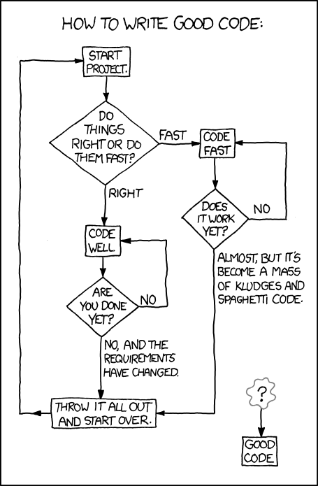

Slide 6
More on File Systems

Slide 7
Journaling file systems
If a regular file system (like ext2) crashes, it might be in an inconsistent state
It has to look through all its i-nodes to try to repair inconsistent data
A journaling file system (like ext3, ext4, and Reiserfs) keeps metadata about the operations it's trying to perform
These operations are called transactions
After a crash, the file system only needs to repair those transactions that weren't completed

Slide 8
File attributes
Files have many attributes, most of which are stored in their i-node
These attributes include:
Device (disk) the file is on
i-node number
File type and permissions
Owner and group
Size
Times of last access, modification, and change
There are functions that will let us retrieve this information in a C program
stat(), lstat(), and fstat()

Slide 9
stat structure
Attributes can be stored in a stat structure
struct stat {
dev_t st_dev; /* IDs of device on which file resides */
ino_t st_ino; /* I-node number of file */
mode_t st_mode; /* File type and permissions */
nlink_t st_nlink; /* Number of (hard) links to file */
uid_t st_uid; /* User ID of file owner */
gid_t st_gid; /* Group ID of file owner */
dev_t st_rdev; /* IDs for device special files */
off_t st_size; /* Total file size (bytes) */
blksize_t st_blksize; /* Optimal block size for I/O (bytes)*/
blkcnt_t st_blocks; /* Number of (512B) blocks allocated */
time_t st_atime; /* Time of last file access */
time_t st_mtime; /* Time of last file modification */
time_t st_ctime; /* Time of last status change */
};

Slide 10
Example with stat()
Let's say you need to find out the size of a file
Which you need to do for Project 6
Technically, the type for st_size is off_t
Files can be large (bigger than INT_MAX bytes)
Since it's not clear what off_t is, you can cast to long (or if you're really worried, long long)
Use stat() if you have a file name and fstat() if you have a file descriptor
struct stat information;
stat (filename, &information);
printf ("The size of %s is %ld bytes.\n", filename, (long)information.st_size);

Slide 11
Function Pointers

Slide 12
Function pointers
C can have pointers to functions
You can call a function if you have a pointer to it
You can store these function pointers in arrays and structs
They can be passed as parameters and returned as values
Java doesn't have function pointers
Instead, you pass around objects that have methods you want
C# has delegates, which are similar to function pointers

Slide 13
Why didn't we cover these before?
K&R group function pointers in with other pointers
I put them off because:
They are confusing
The syntax to declare function pointer variables is awful
They are not used very often
They are not type-safe
But you should still know of their existence!

Slide 14
Declaring a function pointer
The syntax is a bit ugly
Pretend like it's a prototype for a function
Except take the name, put a * in front, and surround that with parentheses
#include <math.h>
#include <stdio.h>
int main()
{
double (*root) (double); // pointer named root
root = &sqrt; // note there are no parentheses
printf( "Root 3 is %lf", root(3) );
printf( "Root 3 is %lf", (*root)(3) ); // also legal
return 0;
}

Slide 15
A more complex example
Some function's prototype:
Its (worthless) definition:
A compatible function pointer:
Function pointer assignment:
int** fizbin(char letter, double length, void* thing);
int** fizbin(char letter, double length, void* thing)
{
return (int**)malloc(sizeof(int*)*50);
}
int** (*pointer)(char, double, void*);
pointer = fizbin;

Slide 16
Two styles
Just to be confusing, C allows two different styles for function pointer assignment and usage
#include <math.h>
#include <stdio.h>
int main()
{
int (*thing) (); // pointer named thing
thing = &main; // looks like regular pointers
thing = main; // short form with & omitted
(*thing)(); // normal dereference
thing(); // short form with * omitted
return 0;
}

Slide 17
Motivation
Why would we want function pointers?

Slide 18
Motivation
Consider a bubble sort that sorts an array of strings
The book uses quicksort as the example, but I don't want to get caught up in the confusing parts of quicksort
void bubbleSort(char* array[], int length)
{
for(int i = 0; i < length – 1; i++ )
for(int j = 0; j < length – 1; j++ )
if(strcmp(array[j],array[j+1]) > 0)
{
char* temp = array[j];
array[j] = array[j + 1];
array[j + 1] = temp;
}
}

Slide 19
Motivation
Now consider a bubble sort that sorts arrays of pointers to single int values
void bubbleSort(int* array[], int length)
{
for(int i = 0; i < length – 1; i++ )
for(int j = 0; j < length – 1; j++ )
if(*(array[j]) > *(array[j+1]))
{
int* temp = array[j];
array[j] = array[j + 1];
array[j + 1] = temp;
}
}

Slide 20
A rectangle struct
Let's pause for a moment in our consideration of sorts and make a struct that can contain a rectangle
typedef struct
{
double x; //x value of upper left
double y; //y value of upper left
double length;
double height;
} Rectangle;

Slide 21
Motivation
Now consider a bubble sort that sorts arrays of pointers to Rectangle structs
Ascending sort by x value, tie-breaking with y value
void bubbleSort(Rectangle* array[], int length)
{
for(int i = 0; i < length – 1; i++ )
for(int j = 0; j < length – 1; j++ )
if(array[j]->x > array[j+1]->x ||
(array[j]->x == array[j+1]->x &&
array[j]->y > array[j+1]->y))
{
Rectangle* temp = array[j];
array[j] = array[j + 1];
array[j + 1] = temp;
}
}

Slide 22
Universal sort
We can write a bubble sort (or ideally an efficient sort) that can sort anything
We just need to provide a pointer to a comparison function
void bubbleSort(void* array[], int length,
int (*compare)(void*, void*))
{
for(int i = 0; i < length – 1; i++ )
for(int j = 0; j < length – 1; j++ )
if(compare(array[j],array[j+1]) > 0)
{
void* temp = array[j];
array[j] = array[j + 1];
array[j + 1] = temp;
}
}

Slide 23
Typechecking
Function pointers don't give you a lot of typechecking
You might get a warning if you store a function into an incompatible pointer type
C won't stop you
And then you'll be passing who knows what into who knows where and getting back unpredictable things

Slide 24
Simulating OOP
C doesn't have classes or objects
It's possible to store function pointers in a struct
If you always pass a pointer to the struct itself into the function pointer when you call it, you can simulate object-oriented behavior
It's clunky and messy and there's always an extra argument in every function (equivalent to the this pointer)
As it turns out, Java works in a pretty similar way
But it hides the ugliness from you
Python doesn't hide as much ugliness, always requiring self

Slide 25
Ticket Out the Door

Slide 26
Upcoming

Slide 27
Next time…
Introduction to C++

Slide 28
Reminders
Start on Project 6

